Slide 1
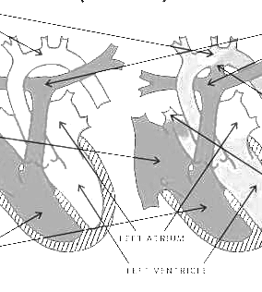
Assisted Early Diagnosis of Persistent Pulmonary Hypertension (PPHN) in Term and Late Preterm Infants
Ananya Kamath and Kameron Chung
Group 5

Slide 2
Introduction
Notes:
Persistent Pulmonary Hypertension of the Newborn (PPHN) is a condition that is prominent in infants, characterized by pulmonary vascular resistance. In infants, this can cause blood shunting and hypoxemia affecting multiple organs (Lakshminrusimha & Keszler, 2015). Combined, these factors can result in decreased oxygen availability which presents as cyanosis, increased work of breathing, acidosis, brain damage, and possible death if not treated early enough (Tauber, 2024). For this project, the target population for early diagnosis of PPHN is term and late preterm infants (gestational ages 37-44 weeks). Looking at early intervention, PPHN can be detected in neonates through analysis of their pre- and postductal oxygen saturation measurements (Tauber, 2024).

Slide 3
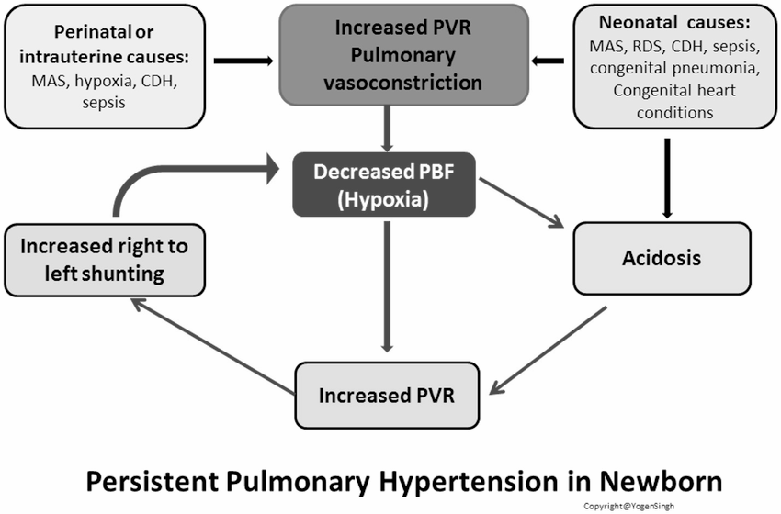
Persistent Pulmonary Hypertension (PPHN)
What is PPHN?
Syndrome characterized by pulmonary vascular resistance
Can cause blood shunting and lack of oxygenated blood in the body
Symptoms
Cyanosis
increased work of breathing
Acidosis
Respiratory distress
Low APGAR score
Meconium staining
(Tauber, 2024)
https://www.researchgate.net/figure/Pathophysiology-of-persistent-pulmonary-hypertension-of-newborn-PPHN-Acute-pulmonary_fig2_325145916

Slide 4
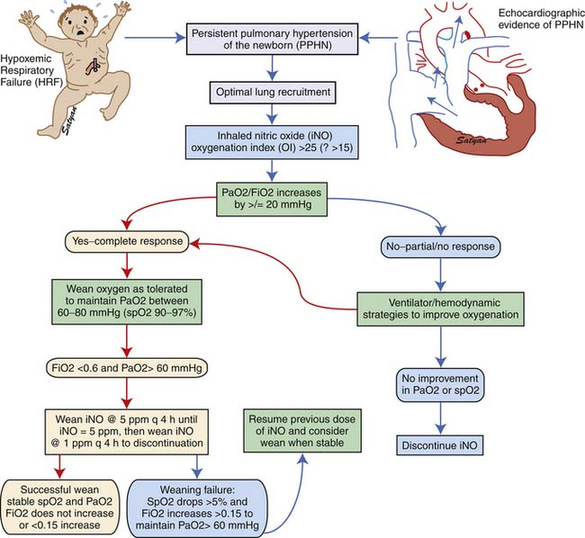
Importance of Treating and Understanding PPHN
Prevalence and Impact -
0.2% of term infants
2% in preterm infants
Increased risk of mortality
Long Term Consequences -
Neurodevelopmental delays
Cognitive delays
Hearing impairment
(Lakshminrusimha & Keszler, 2015)

Slide 5
Causes and Risk Factors
Causes
Transition from fetal circulation to extrauterine circulation fails
Risk Factors
Distress at birth
Meconium aspiration
Respiratory Distress Syndrome
Maternal hypertension
Congenital abnormalities
(Razzaq et. al., 2013)
Notes:
PPHN happens when the transition from fetal circulation to extrauterine circulation fails. For a fetus in utero, the lungs are full of fluid and there is a steady state of hypertension within the lungs because the placenta is responsible for oxygenation of the fetus. This is maintained by certain valves within the heart called the ductus arteriosus and foramen ovalle. Once the fetus is born, the pressure gradient within the circulatory system shifts; the valves close and the lungs expand and begin oxygenating the baby. If this fails and the valves fail to close, PPHN can occur.

Slide 6
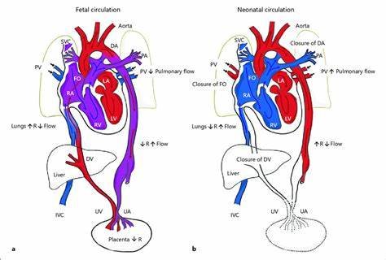
Types of PPHN
Primary
Failed transition
Acquired
Prolonged mechanical ventilation
(Singh & Lakshminrusimha, 2021)
Risk severity -
In this case relates to the type of treatment intervention needed and future mortality risk
Mild
Moderate
Severe
Notes:
There are two types of PPHN, Primary and acquired. Primary PPHN is developed directly after birth due to a failure in transitioning from fetal to neonatal circulation. Acquired PPHN can be caused later in life by complications such as meconium aspiration, prolonged respiratory distress, or increased pulmonary pressure due to prolonged mechanical ventilation.
While there are no severity levels of PPHN, the risk of PPHN can be measured as mild, moderate or severe risk for acquiring PPHN based on factors such as maternal and fetal history, APGAR scores, presence of meconium-stained fluid and so on.

Slide 7
Proposed AI Model
Notes:
The proposed model would provide significant support in clinical settings such as Pediatric and Neonatal Intensive Care Units. PPHN typically develops and presents within the first 12 hours following birth (Nandula & Shah, 2023). Due to the presentation period of this complication, most diagnoses happen within the NICU and treatment may be escalated to neonatal or pediatric cardiology. When an infant is born, the entire circulatory system is rerouted in order to transition from placental oxygenation to pulmonary oxygenation. When an issue with this transition occurs, PPHN can develop. Given the severity of the condition, patients who are stabilized at birth will still require continuous monitoring. Depending on the development of the model, there is the potential for remote patient monitoring to provide long-term early intervention.

Slide 8
Objective: Providing NICU physicians with assisted early diagnosis of Persistent Pulmonary Hypertension (PPHN) in Term and Late Preterm Infants by dynamically assessing the severity and mortality risk
Key Features:
ICD-10 code checker
Patient specific input and integration
Mortality risk calculation
Remote Symptom Monitoring
Treatment Plan Recommendations

Slide 9
Methodology
ICD Codes
ICD Code | Diagnosis
P29.3 | Persistent pulmonary hypertension of the newborn
P28.5 | Respiratory failure of newborn
P22.0 | Respiratory distress syndrome of newborn
P28.4 | Other apnea of newborn
P24.0 | Meconium aspiration syndrome
P36.0 | Sepsis of newborn
ICD-10 codes relevant to the model and to the treatment/diagnosis of PPHN

Slide 10
Methodology
Input Layer
In all, these are the elements the physician will enter into the model:
Gestational Age
Gender
Delivery Mode
Presence of Key Conditions
Respiratory Support
Output Layer
In all, these are the elements the model will provide
PPHN Severity
Mortality Risk %
Recommended Action Items / Treatment Plans
Remote Symptom Tracking
Disease Summary

Slide 11
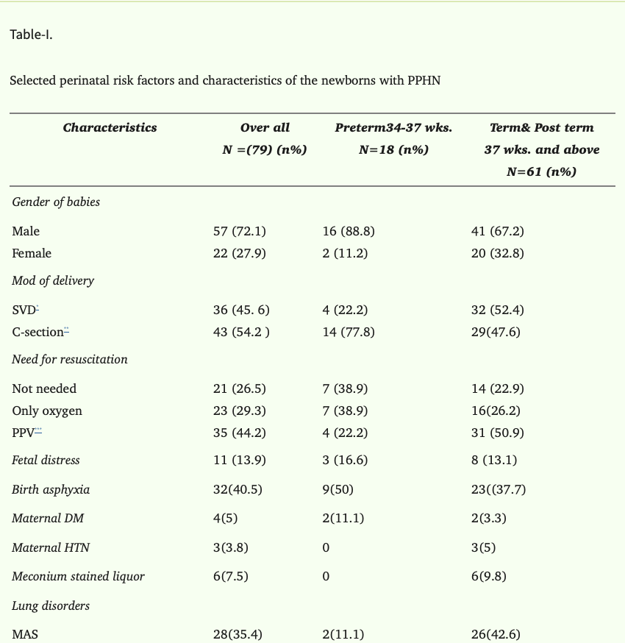
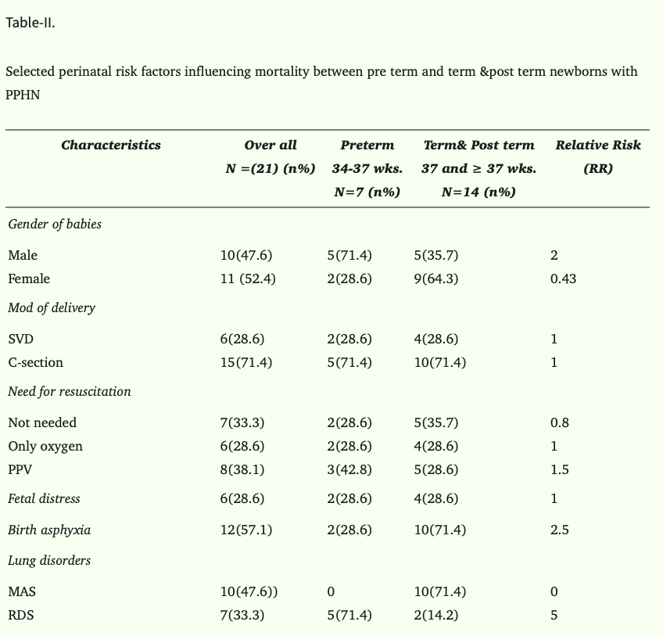
PPHN Dataset
This was an observational study conducted at The Children’s Hospital & the Institute of Child Health, Multan, Pakistan, from July 2011 to June 2012.
All admitted babies who had respiratory distress, cyanosis and evidence of hypoxia on ABG,s were diagnosed
Key Points -
Defining feature importance (via RR)
Modeling patient outcomes
Creating clinical guidelines for follow-up
No PII used – dataset is anonymized and based on published summary data

Slide 12
A Simple Linear Regression to calculate mortality risk based on weighted risk factors was used
Why?
Transparent and explainable in clinical settings
-Good alignment with small, tabular, non-time series datasets
Usage within model:
Each risk factor has a relative risk (RR)
Combined into a weighted mortality score
Plotted against a simulated population of patient outcomes
ICD checker, monitoring schedule, and symptom tracking use rules-based logic — deterministic and interpretable.
Mortality risk is data-driven (linear model), leveraging relative risks and raw outcome data.
This hybrid approach ensures both clinical reliability and scalability.

Slide 13
Code Review

Slide 14
ICD Code Checker

Slide 15
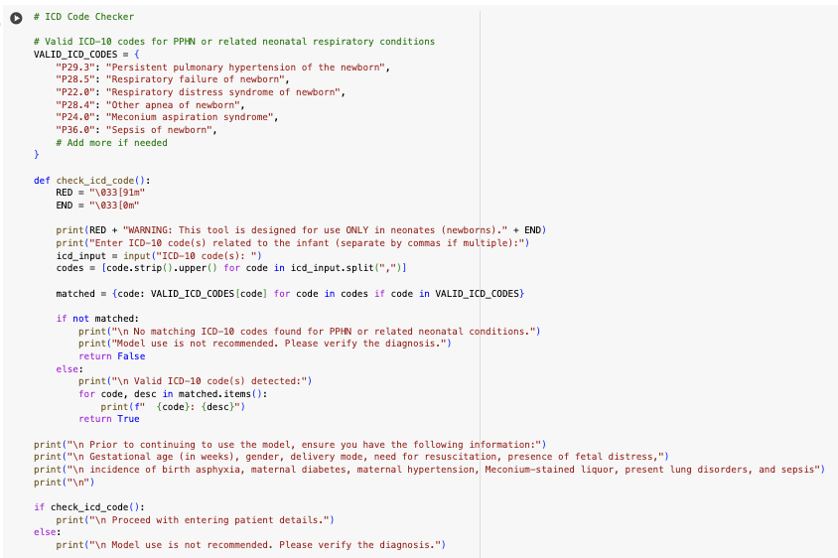

Slide 16
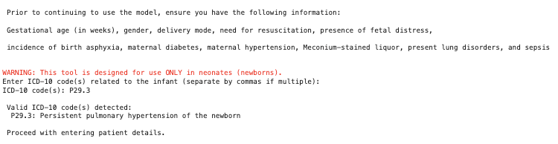
Output

Slide 17
APGAR Score Calculator

Slide 18
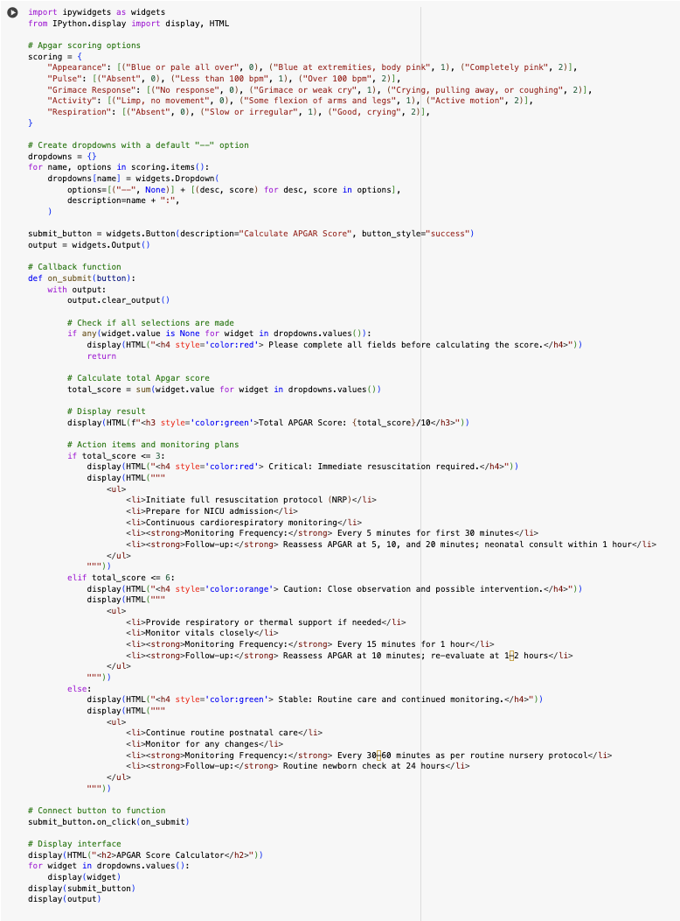
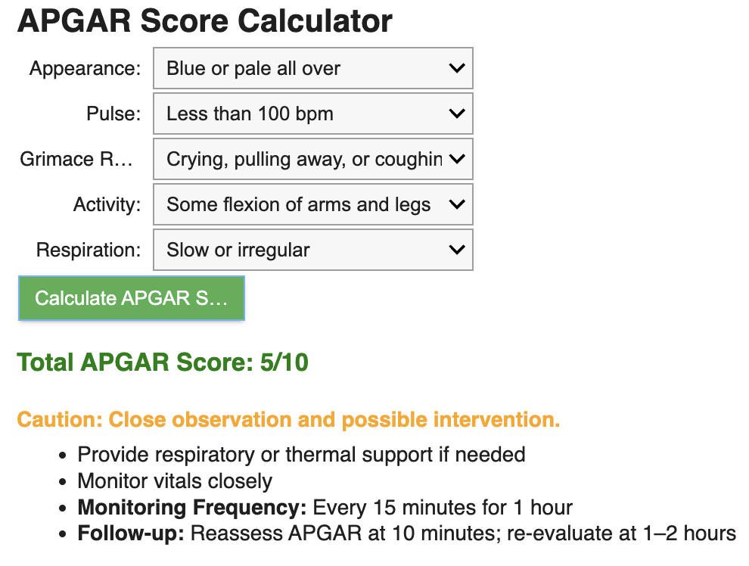

Slide 19
PPHN NICU
Assessment Tool

Slide 20
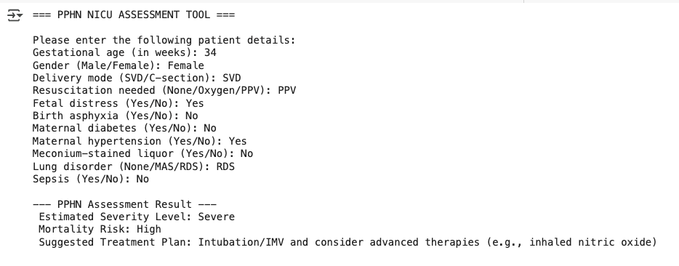
Example inputs

Slide 21
NICU PPHN Mortality Risk Predictor

Slide 22
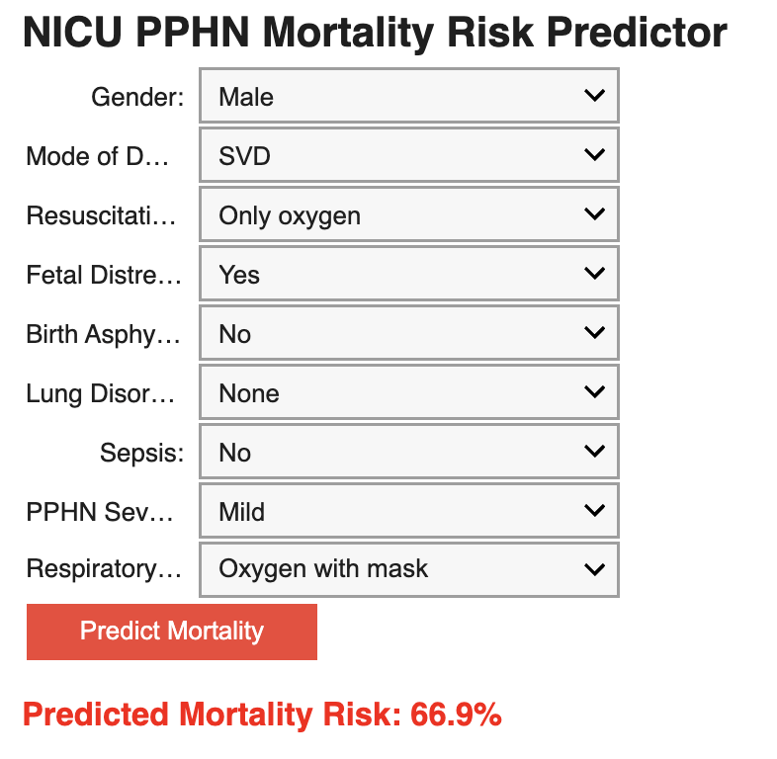
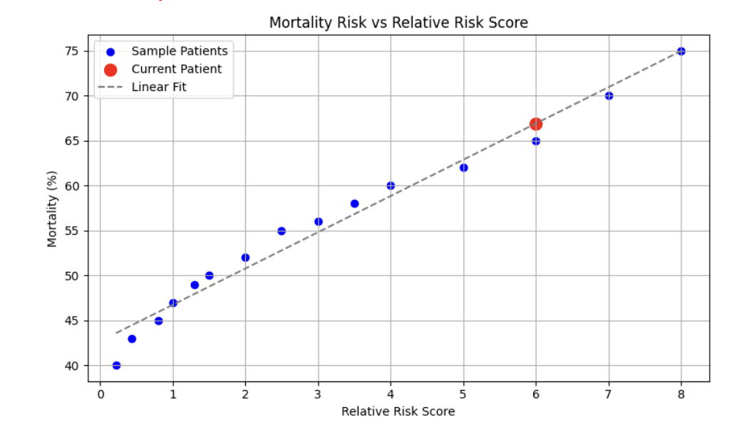

Slide 23
Treatment Plan Support

Slide 24
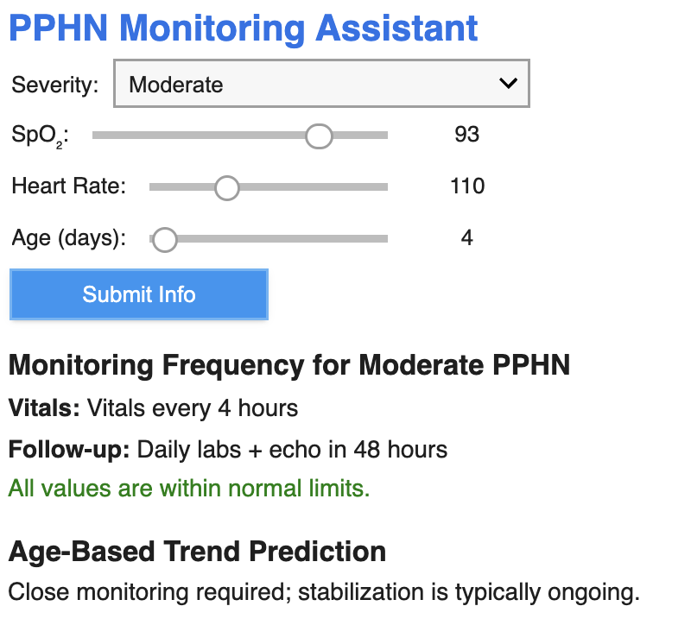
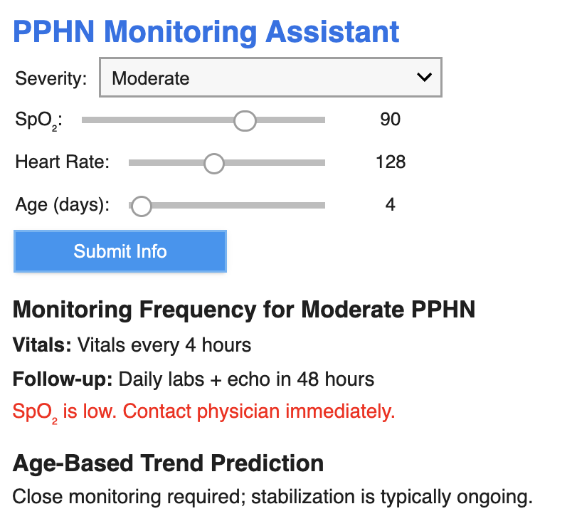

Slide 25
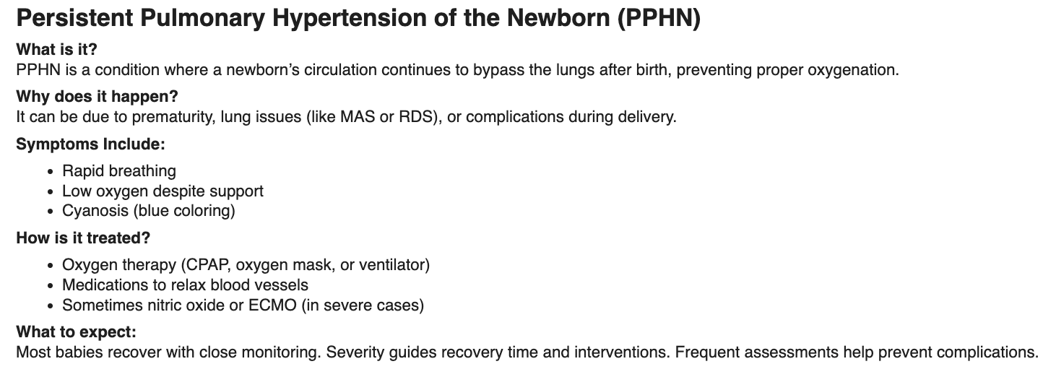

Slide 26
Performance Metrics

Slide 27
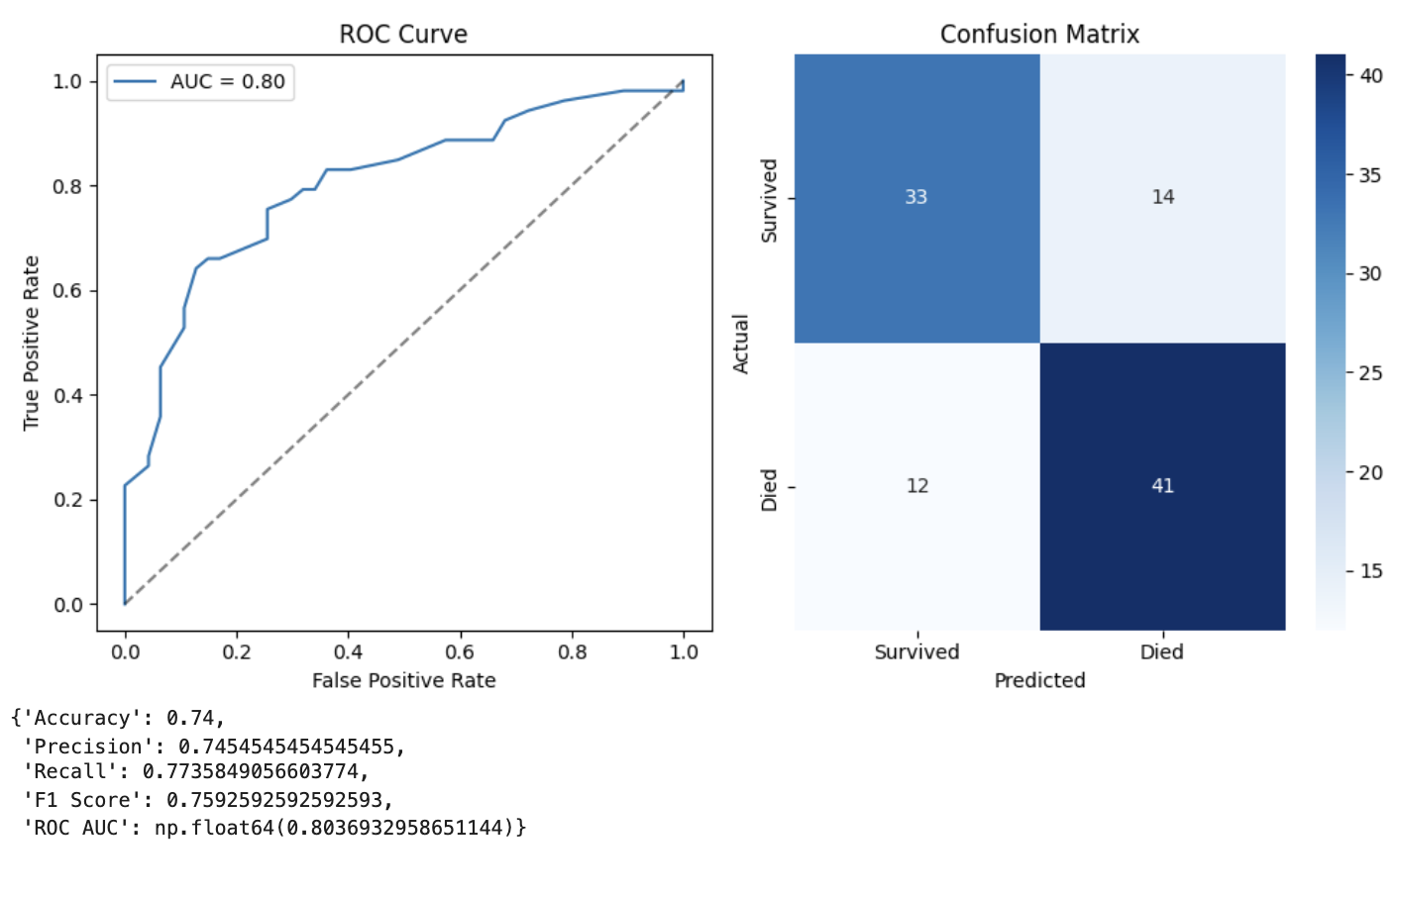

Slide 28
Closing Thoughts

Slide 29
Data Challenges
Future Recommendations
During future use this model should be trained with real data as opposed to synthetic data
A large sample size of labelled data is essential to providing accuracy to this model
The original dataset was too large for the functionality of Google Colab
Additionally, the data was unlabelled and unstructured which made it difficult to integrate into the model
There is extremely limited labelled data on patients with PPHN
Future use:
Facilities with limited resources and specialists
NICU’s experiencing role strain
Individuals dealing with a diagnosis of PPHN

Slide 30
References
Lakshminrusimha S, Keszler M. Persistent Pulmonary Hypertension of the Newborn.
Neoreviews. 2015 Dec;16(12):e680-e692. doi: 10.1542/neo.16-12-e680. PMID:
26783388; PMCID: PMC4714607.
Nandula PS, Shah SD. Persistent Pulmonary Hypertension of the Newborn. [Updated 2023 Jul
31]. In: StatPearls [Internet]. Treasure Island (FL): StatPearls Publishing; 2025 Jan-.
Available from: https://www.ncbi.nlm.nih.gov/books/NBK585100/
Razzaq, A., Iqbal Quddusi, A., & Nizami, N. (2013, September). Risk factors and mortality among newborns with
persistent pulmonary hypertension. Pakistan journal of medical sciences. https://pmc.ncbi.nlm.nih.gov/a
rticles/PMC3858931/#:~:text=Results:%20There%20were%2079%20patients,term%20and%20post%20term%2
0infants

Slide 31
References cont.
Singh, Y., & Lakshminrusimha, S. (2021). Pathophysiology and Management of Persistent Pulmonary Hypertension of the Newborn.
Clinics in perinatology, 48(3), 595–618. https://doi.org/10.1016/j.clp.2021.05.009
Steurer, M. A., Jelliffe-Pawlowski, L. L., Baer, R. J., Partridge, J. C., Rogers, E. E., & Keller, R. L. (2017). Persistent Pulmonary
Hypertension of the Newborn in Late Preterm and Term Infants in California. Pediatrics, 139(1), e20161165.https://doi.org/10.1542/peds.2016-1165
Tauber, K. A. (2024, October 29). Persistent pulmonary hypertension of the newborn (PPHN). Practice Essentials, Background,
Etiology. https://emedicine.medscape.com/article/898437-overview#:~:text=Failure%20of%20circulato
ry%20transition,or%20at%20the%20 foramen%20 ovale

